Slide 1

Change in Si Volume in correlation to electrochemical Lithiation
Initial Findings and Discussion
Created By: Joshua Eastgaard

Slide 2
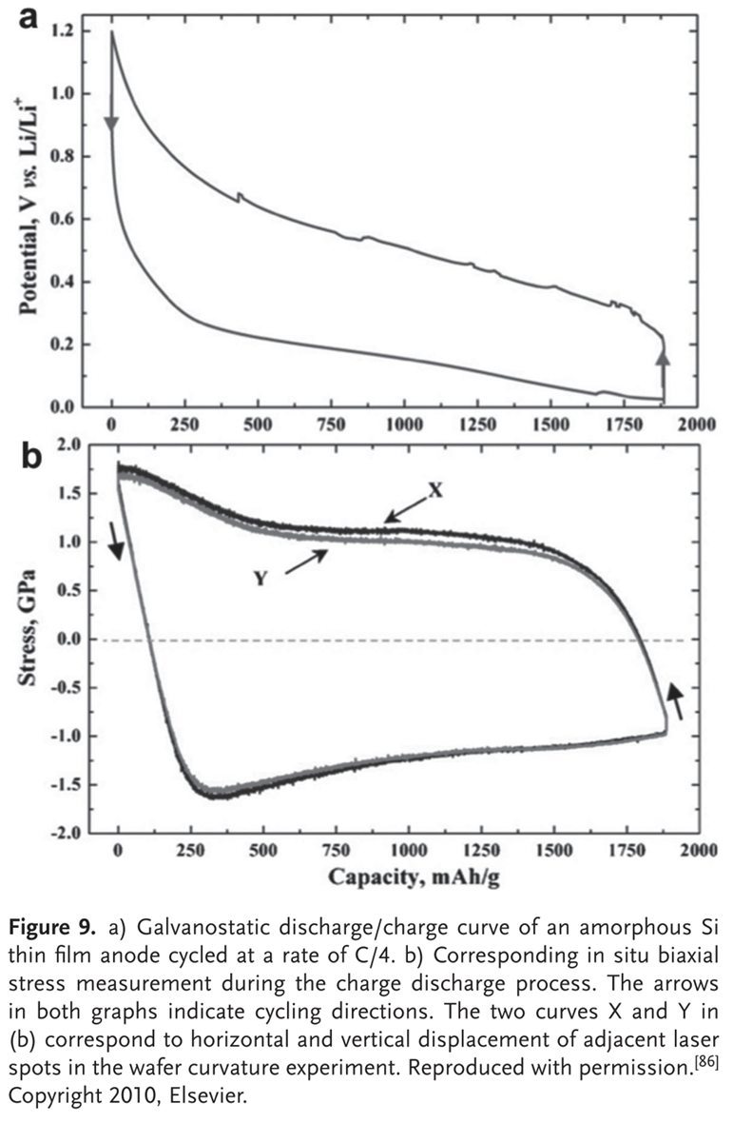
Core Findings
Lithium uptake is directly responsible for silicon volume expansion.
The amount of lithium inserted into silicon directly determines the degree of volume expansion.
Silicon undergoes alloying reactions with lithium, forming a series of Li_{x} Si phases.
This volume expansion is non-uniform creating stress gradients inside the material.
Reversibility of volume change is limited.
Volume expansion is the root cause of mechanical degradation.

Slide 3
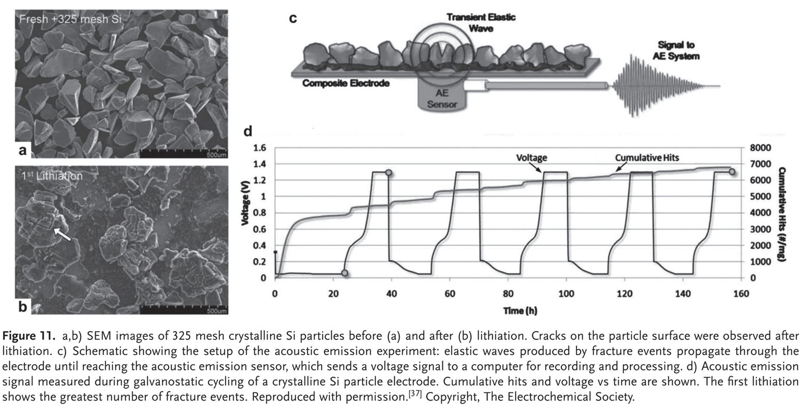
Non-Linear/Non-Uniform Volume Expansion:
Important Points to Observe:
Initial stress formation, mechanical fractures, and irreversible side reactions occur during initial charge/discharge.
Spatially heterogeneous (lithium reacts locally, creating regions with different Li con.)
Differences in lithiation state create sharp boundaries between expanded and less-expanded regions.
Notes:
During repeated lithiation and delithiation, spatial heterogeneity is maintained or amplified.
Even if average volume expansion is known, local expansion mismatches dominate mechanical failure.
Sharp boundaries generate significant mechanical strain due to constrained expansion

Slide 4
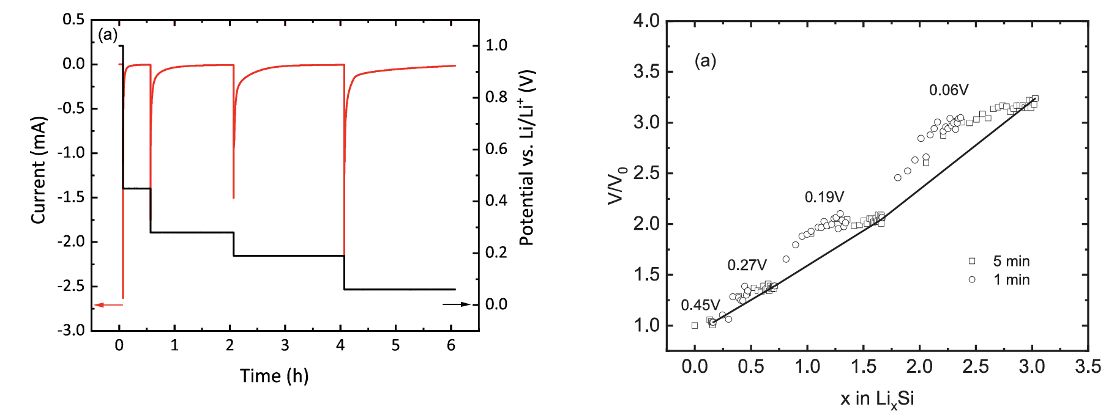
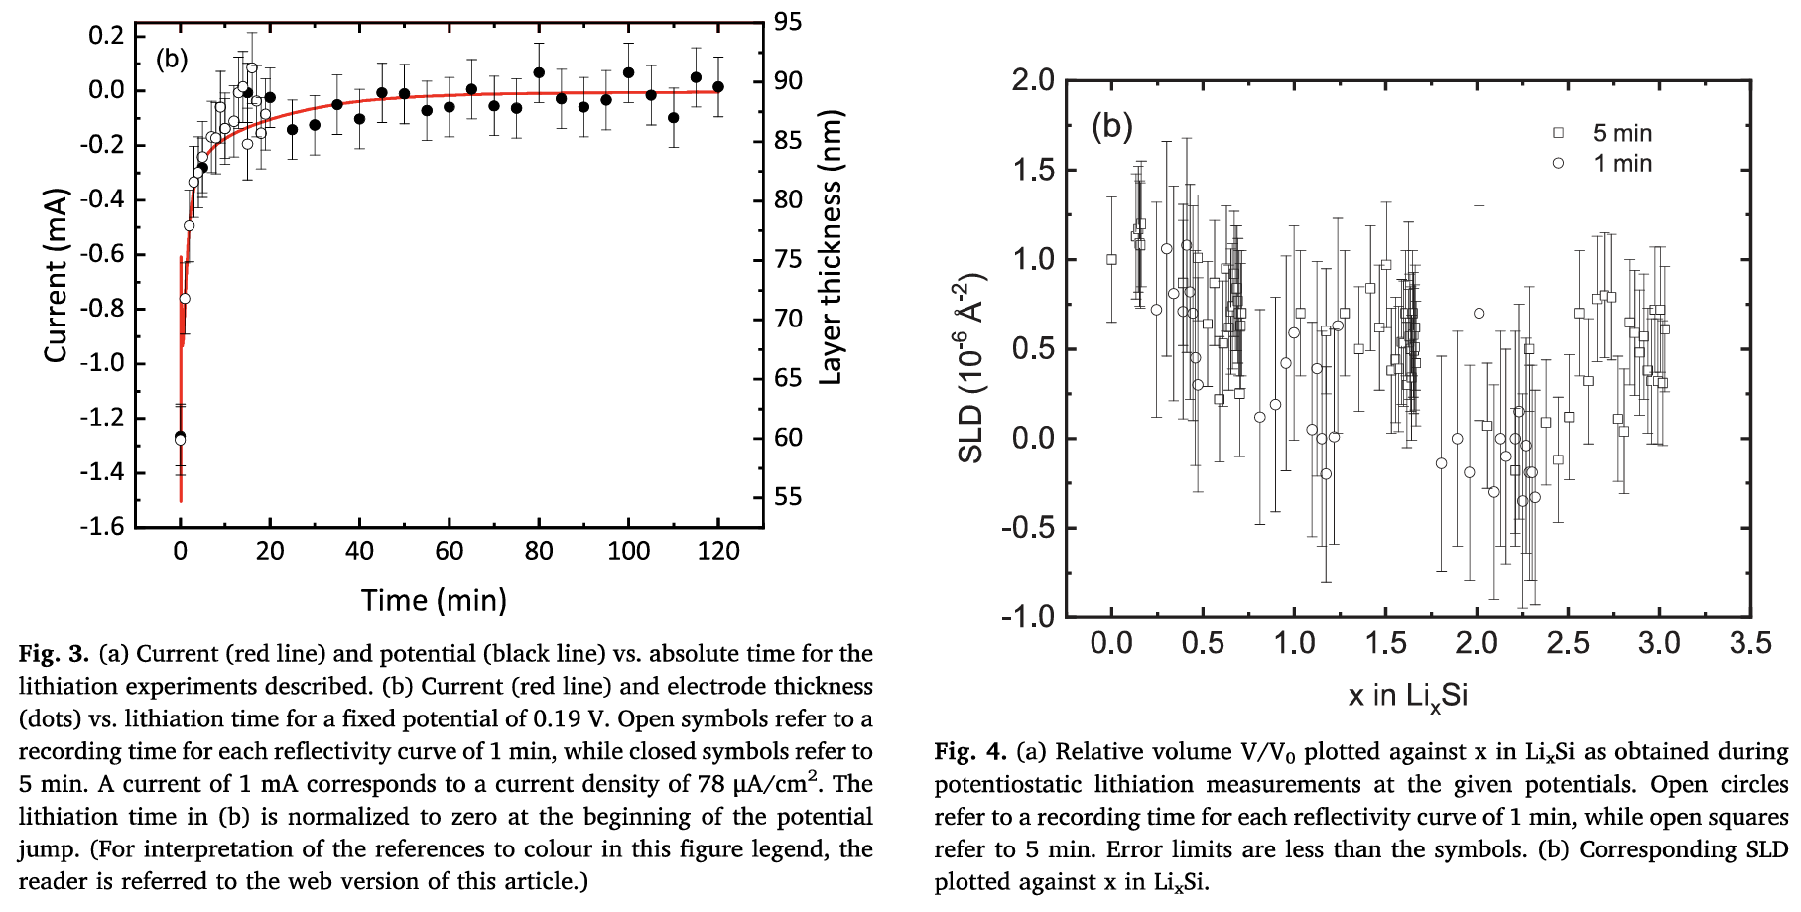
Current Vs Lithiation of Si:
During potentiostatic lithiation , electrochemical current reflects the rate of lithium insertion into silicon.
Different current regimes correspond to different expansion behaviors.
Nonlinear relationship between current and volume expansion
Distinct volume increases at similar states of charge
Notes:
SLD: Scattering Length Density If all the dots in the SLD VS x were grouped together, that would mean that the lithiation was even. Thus, different parts of the Si are lithiated differently. Even lithiation would mean that for every x, there would be a straight vertical line.
As lithiation proceeds, current decreases while volume expansion continues to increase, indicating ongoing structural changes despite reduced lithium insertion rates.
Significant expansion can occur even when current is low, demonstrating that expansion depends on the accumulated lithiation state rather than current alone.
Silicon electrodes can exhibit different relative volume expansions at similar lithium contents, depending on the lithiation pathway and current history. This indicates that the mechanical response of silicon is sensitive to lithiation kinetics, not only lithium concentration

